Slide 1


Inventra Intelligent Inventory Management System

Slide 2

Meaning of the project
Inventra is an Inventory Management System that automates stock tracking, forecasting, and order management.
It aims to reduce human errors, optimize stock levels, and improve business efficiency.
Inventra = Inventory + Intelligent Automation

Slide 3


Table of contents
Module 1: Authentication
Module 2:
Product and Inventory Management

Slide 4
Module 1 : Authentication
The Authentication Module manages user login, registration, and access control.
Classes are :
1. User
Use: Stores user information (name, email, role).
Purpose: Identifies each user in the system.
2. AuthController
Use: Handles login, signup, and logout API requests.
Purpose: Receives user input and communicates with AuthService.
3. AuthService
Use: Validates credentials, encrypts passwords, generates JWT tokens.
Purpose: Core logic of authentication and authorization.
4. UserRepository
Use: Interacts with the database to fetch/save user records.
Purpose: Provides CRUD operations for users.
5. JwtUtil
Use: Generates, validates, and refreshes JWT tokens.
Purpose: Ensures secure communication between client and server.

Slide 5

Database Schema
Table: users
Column Name | Type | Description
user_id (PK) | INT | Unique user identifier
name | VARCHAR(100) | User full name
email | VARCHAR(150) | Unique email for login
password | VARCHAR(255) | Encrypted password
role | VARCHAR(50) | Admin / Manager / Staff
created_at | DATETIME | Account creation time
updated_at | DATETIME | Last update timestamp

Slide 6

 | Column Name | Type | Description
 | role_id (PK) | INT | Unique role ID
 | role_name | VARCHAR(50) | Role type
Table: roles
Table: user_roles
Column Name | Type | Description
user_id (FK) | INT | Linked to users table
role_id (FK) | INT | Linked to roles table

Slide 7


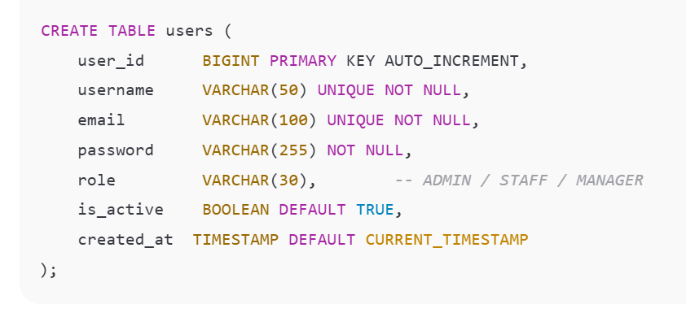
Flow:

Slide 8
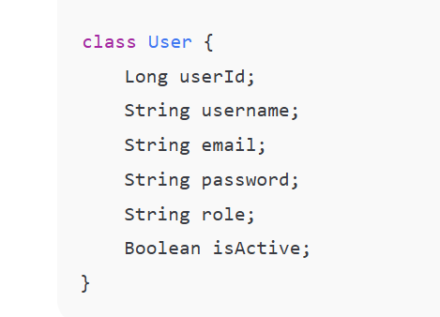
User Class –users Table

Slide 9
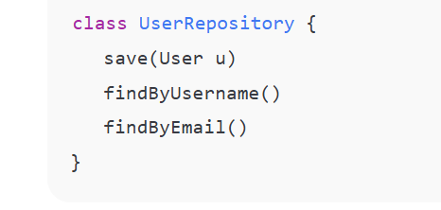
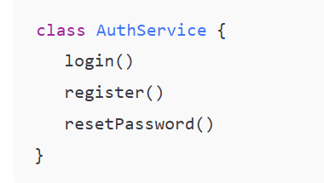
Repository Class Service Class

Slide 10
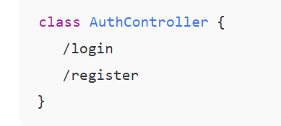
Controller Class

Slide 11
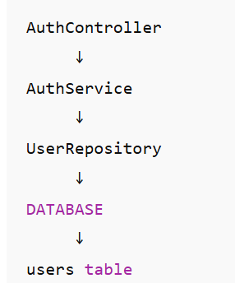
Flow With Database

Slide 12

AUTHENTICATION MODULE – PSEUDOCODE
Classes involved
AuthController
AuthService
User
UserRepository
JWTUtility
EmailService (for forgot password)

Slide 13
1.SIGN-UP (REGISTER USER) 🔹 Purpose Create a new user account Only Admin can register employees
# AuthController – Signup
CLASS AuthController
FUNCTION signup(request)
userDetails = request data
result = AuthService.registerUser(userDetails)
RETURN result
END FUNCTION
END CLASS

Slide 14
## AuthService – Signup Logic CLASS AuthService FUNCTION registerUser(userDetails) existingUser = UserRepository.findByUsername(userDetails.username) IF existingUser exists THEN RETURN "User already exists" END IF encryptedPassword = encrypt(userDetails.password)
newUser.role = userDetails.role
newUser.email = userDetails.email
UserRepository.save(newUser)
RETURN "Signup successful"
END FUNCTION
END CLASS
newUser = create User
newUser.username = userDetails.username
newUser.password = encryptedPassword

Slide 15
2. Sign-in (LOGIN USER) 🔹 Purpose Authenticate user Generate secure token
# AuthController – Signin
CLASS AuthController
FUNCTION signin(request)
username = request.username
password = request.password
token = AuthService.authenticate(username, password)
RETURN token
END FUNCTION
END CLASS

Slide 16
## AuthService – Signin Logic CLASS AuthService FUNCTION authenticate(username, password) user = UserRepository.findByUsername(username) IF user does not exist THEN RETURN "Invalid username" END IF IF password matches encrypted password THEN token = JWTUtility.generateToken(user) RETURN token ELSE RETURN "Invalid password" END IF END FUNCTION END CLASS

Slide 17
### AuthController – Forgot Password CLASS AuthController FUNCTION forgotPassword(request) email = request.email result = AuthService.processForgotPassword(email) RETURN result END FUNCTION END CLASS
####AuthService – Forgot Password Logic
CLASS AuthService
FUNCTION processForgotPassword(email)
user = UserRepository.findByEmail(email)
IF user does not exist THEN
RETURN "Email not registered"
END IF
resetToken = generateResetToken()
save resetToken with user
EmailService.sendResetLink(email, resetToken)
RETURN "Password reset link sent"
END FUNCTION
END CLASS

Slide 18
# EmailService – Reset Email CLASS EmailService FUNCTION sendResetLink(email, token) create reset password link using token send email to user END FUNCTION END CLASS
#####RESET PASSWORD (After clicking link)
CLASS AuthController
FUNCTION resetPassword(token, newPassword)
result = AuthService.resetPassword(token, newPassword)
RETURN result
END FUNCTION
END CLASS
CLASS AuthService
FUNCTION resetPassword(token, newPassword)
user = find user by reset token
IF token invalid or expired THEN
RETURN "Invalid token"
END IF
encryptedPassword = encrypt(newPassword)
user.password = encryptedPassword
clear reset token
save user
RETURN "Password reset successful"
END FUNCTION
END CLASS

Slide 19

Module : 2 Product and Inventory Management System
02

Slide 20
The purpose of this module is to allow the system to store complete product details such as: 1.Product name 2.Category 3.Quantity 4.Price 5.Suppliers 6.Reorder Level 7.Stock Transactions
Main Classes in this Module is:
1.Product
2.Product Controller
3.Product Service
4.Product Respository

Slide 21
Flow: AuthController—AuthService—UserRespository--Database
Purpose
Manage products
Track stock levels
Prevent duplicate items

Slide 22
1.Product Class (Entity) Pseudocode CLASS Product productId sku name category supplier unitPrice stockQuantity minStockLevel END CLASS Explanation •sku ensures uniqueness •stockQuantity changes frequently •minStockLevel used for alert
2. ProductController Class
Pseudocode
CLASS ProductController
FUNCTION addProduct(productData)
ProductService.addProduct(productData)
END FUNCTION
FUNCTION stockIn(productId, quantity)
ProductService.increaseStock(productId, quantity)
END FUNCTION
FUNCTION stockOut(productId, quantity)
ProductService.decreaseStock(productId, quantity)
END FUNCTION
END CLASS
Explanation
Receives UI requests
Sends work to service layer
Does not touch database directly

Slide 23
3. ProductService Class Pseudocode CLASS ProductService FUNCTION addProduct(productData) IF product SKU not exists THEN save product ELSE RETURN "Duplicate Product" END IF END FUNCTION FUNCTION increaseStock(productId, quantity) product.stock += quantity save product TransactionService.log("STOCK_IN", productId, quantity) AlertService.checkLowStock(product) END FUNCTION
FUNCTION decreaseStock(productId, quantity)
IF product.stock >= quantity THEN
product.stock -= quantity
save product
TransactionService.log("STOCK_OUT", productId, quantity)
AlertService.checkLowStock(product)
ELSE
RETURN "Insufficient Stock"
END IF
END FUNCTION
END CLASS
Explanation
•Central inventory logic
•Updates stock
•Logs transactions
•Triggers alerts

Slide 24
4.ProductRepository Class
Pseudocode
CLASS ProductRepository
FUNCTION findById(productId)
RETURN product
END FUNCTION
FUNCTION save(product)
store product in database
END FUNCTION
END CLASS

Slide 25
Database Schema:
Class | Need DB table? | Reason
Product (model) | Yes | Stores product details
Product Repository | No | only perform DB queries
Product Service | No | Business logic layer
Product Controller | No | Request handling layer
➡ Only the product class requires a database table

Slide 26
CREATE TABLE Products (
product_id BIGINT PRIMARY KEY AUTO-INCREMENT, sku VARCHAR(50) UNIQUE, name VARCHAR(150) NOT NULL, description TEXT, unit_price DECIMAL(10,2), quantity INT, reorder_level INT, created_at TIMESTAMP DEFAULT CURRENT_TIMESTAMP
);

Slide 27
Product class
Class Product {
Long productId; String sku; String name; String description; Double unitPrice; Integer quantity; Integer reorderLevel;
}
Repository class
class ProductRepository {
save(Product p) findById() findAll()
}
Service class
class ProductService {
addProduct() updateProduct() deleteProduct()
}

Slide 28
Controller class
class ProductController {
createProduct viewProducts
}
Product flow
Product Controller ↓ Product Service ↓ Product Repository ↓ Database (Products table)

Slide 29

THANK YOU

